Slide 1
5. Data
Analytics
Markowitz
mean-variance Model

Slide 2

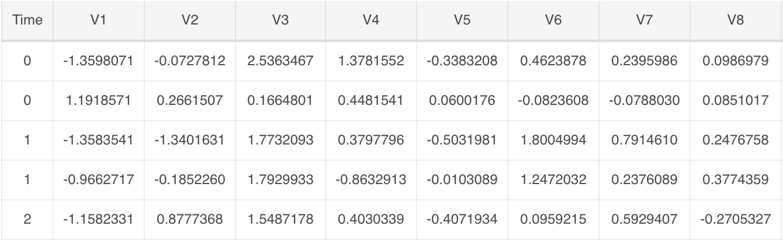
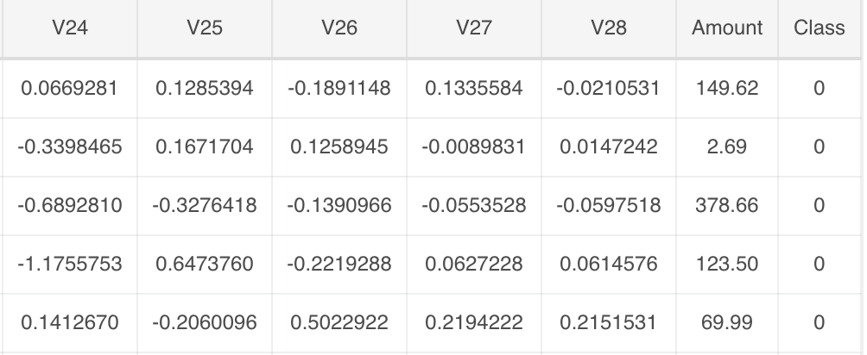
5.1 Data
Accessing
Dataset: 284,807 transaction records with 492 frauds and 284315 normal customers
Features: V1, V2, ... V28 are the principal components obtained with PCA, the only features which have not been transformed with PCA are 'Time' and 'Amount'.
Feature 'Class' is the response variable and it takes value 1 in case of fraud and 0 otherwise.

Slide 3
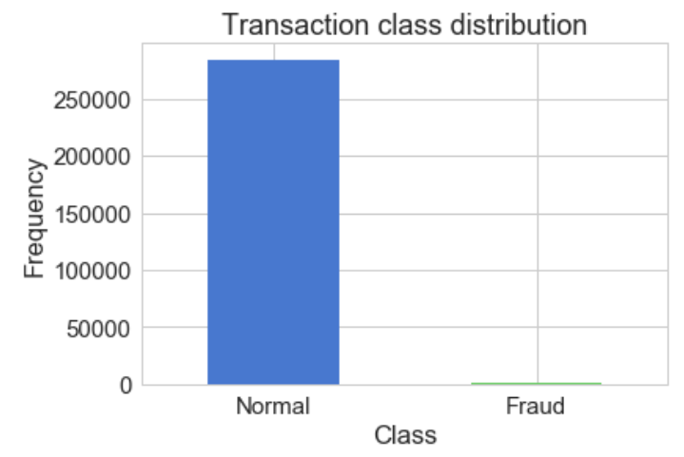
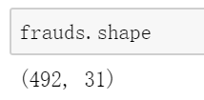
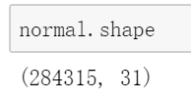
5.2 EDA
Heavily imbalanced dataset! → Oversampling
SMOTE — Synthetic Minority Over-sampling Technique
Finding the k-nearest-neighbors for minority class observations (finding similar observations)
Randomly choosing one of the k-nearest-neighbors and using it to create a similar, but randomly tweaked, new observations.

Slide 4
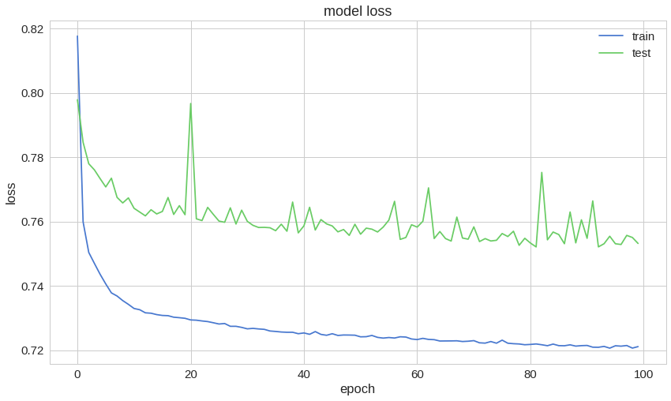
5.3 Train Model
The reconstruction error on our training and test data seems to converge nicely

